Slide 1
Solar Powered-Remote Controlled Grass Cutter Robot
Mini Project
Electronics and Communication Engineering

Slide 2
group no. 17 members:
Radhika M(133)
Vaishnavi C A(169)
Rahul Manoharan(135)
Rahul Krishna H(134)

Slide 3
INTRODUCTION
Automation is increasingly used in agriculture and lawn maintenance.
Traditional grass cutting requires human effort and fuel-based machines.
These machines cause pollution and require constant supervision.
Our project introduces a solar-powered robotic solution.

Slide 4
Problem Statement
Manual grass cutting is time consuming.
Fuel powered machines cause environmental pollution.
Electric cutters require continuous wired power.
Safety risks for the operator.

Slide 5
Objective
To design and develop a solar powered grass cutter robot.
To reduce human effort in lawn maintenance.
To utilize renewable energy for eco‑friendly operation.
To control the robot wirelessly.

Slide 6
Components Used
Solar Panel
Rechargeable Battery
Charge controller
HC-05 Bluetooth module
Arduino UNO
Motor Driver Modules
DC Geared Motors
DC Cutter Motor
Relay Module
Buck Converter

Slide 7
Working Principle
Solar panel charges the battery during sunlight.
Bluetooth module receives control commands wirelessly.
Commands are given and controlled through Arduino.
Motor drivers rotate wheels based on commands.
Relay activates the cutter motor for grass cutting.

Slide 8
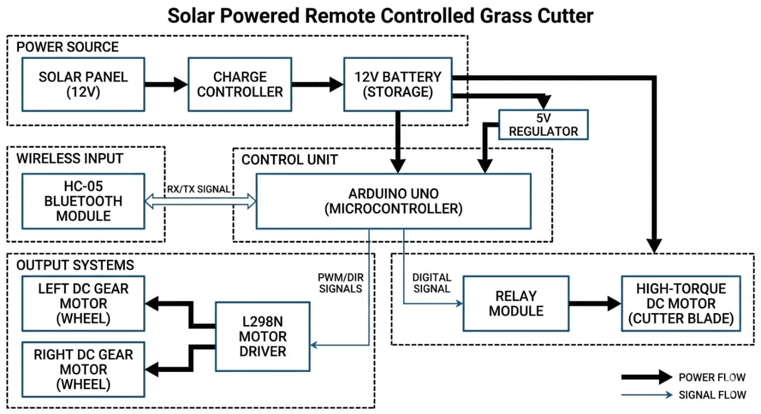
Block Diagram
Solar Panel → Battery → Buck Converter
Power Supply → ESP32 & Arduino UNO
ESP32 → Motor Driver → Wheel Motors
Arduino UNO → Relay → Cutter Motor

Slide 9
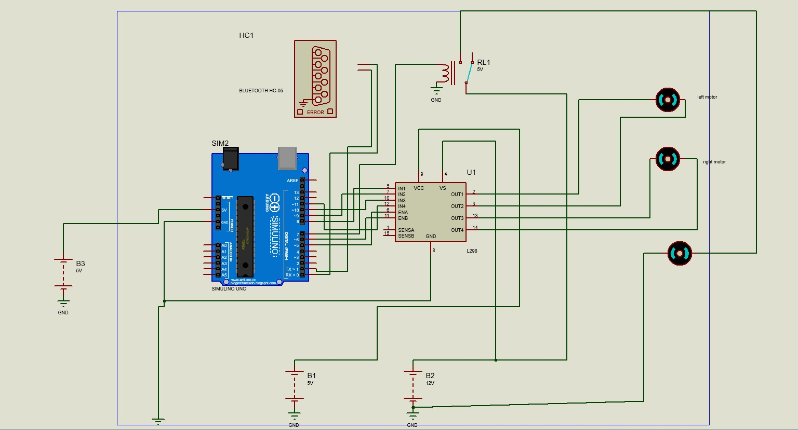
Circuit Diagram
CIRCUIT DIAGRAM
Solar panel charges the 12V battery.
Buck converter steps down voltage for controllers.
ESP32 controls robot movement via motor drivers.
Relay controls cutter motor ON/OFF operation.

Slide 10
ARDUINO Code
// --- Pin Definitions --- // Connect these pins from Arduino to the L298N Motor Driver const int IN1 = 8; // Left motors const int IN2 = 9; // Left motors const int IN3 = 10; // Right motors const int IN4 = 11; // Right motors // If you have a relay for the cutter blade const int CUTTER_RELAY = 12; char command; // Variable to store incoming Bluetooth data
Void setup() { // Set all motor pins as outputs pinMode(IN1, OUTPUT); pinMode(IN2, OUTPUT); pinMode(IN3, OUTPUT); pinMode(IN4, OUTPUT);

Slide 11
ARDUINO CODE
// Set cutter relay as output pinMode(CUTTER_RELAY, OUTPUT); digitalWrite(CUTTER_RELAY, LOW); // Start with cutter OFF // Start Serial communication at 9600 baud for Bluetooth Serial.begin(9600);} void loop() { if (Serial.available() > 0) { command = Serial.read(); // Read the character sent from phone // Choose action based on the character received switch (command) { case ‘F’: forward(); break; case ‘B’: backward(); break; case ‘L’: left(); break; case ‘R’: right(); break; case ‘S’: stopMotors(); break; case ‘W’: digitalWrite(CUTTER_RELAY, HIGH); break; // Cutter ON case ‘w’: digitalWrite(CUTTER_RELAY, LOW); break; // Cutter OFF } }}

Slide 12
ARDUINO CODE
// --- Direction
Functions --- void forward() { digitalWrite(IN1, HIGH); digitalWrite(IN2, LOW); digitalWrite(IN3, HIGH); digitalWrite(IN4, LOW);} void backward() { digitalWrite(IN1, LOW); digitalWrite(IN2, HIGH); digitalWrite(IN3, LOW); digitalWrite(IN4, HIGH) } void left() { digitalWrite(IN1, LOW); digitalWrite(IN2, HIGH); // Left moves back digitalWrite(IN3, HIGH); digitalWrite(IN4, LOW); // Right moves forward}
Void right() { digitalWrite(IN1, HIGH); digitalWrite(IN2, LOW); // Left moves forward digitalWrite(IN3, LOW); digitalWrite(IN4, HIGH); // Right moves back } void stopMotors() { digitalWrite(IN1, LOW); digitalWrite(IN2, LOW); digitalWrite(IN3, LOW); digitalWrite(IN4, LOW); }

Slide 13
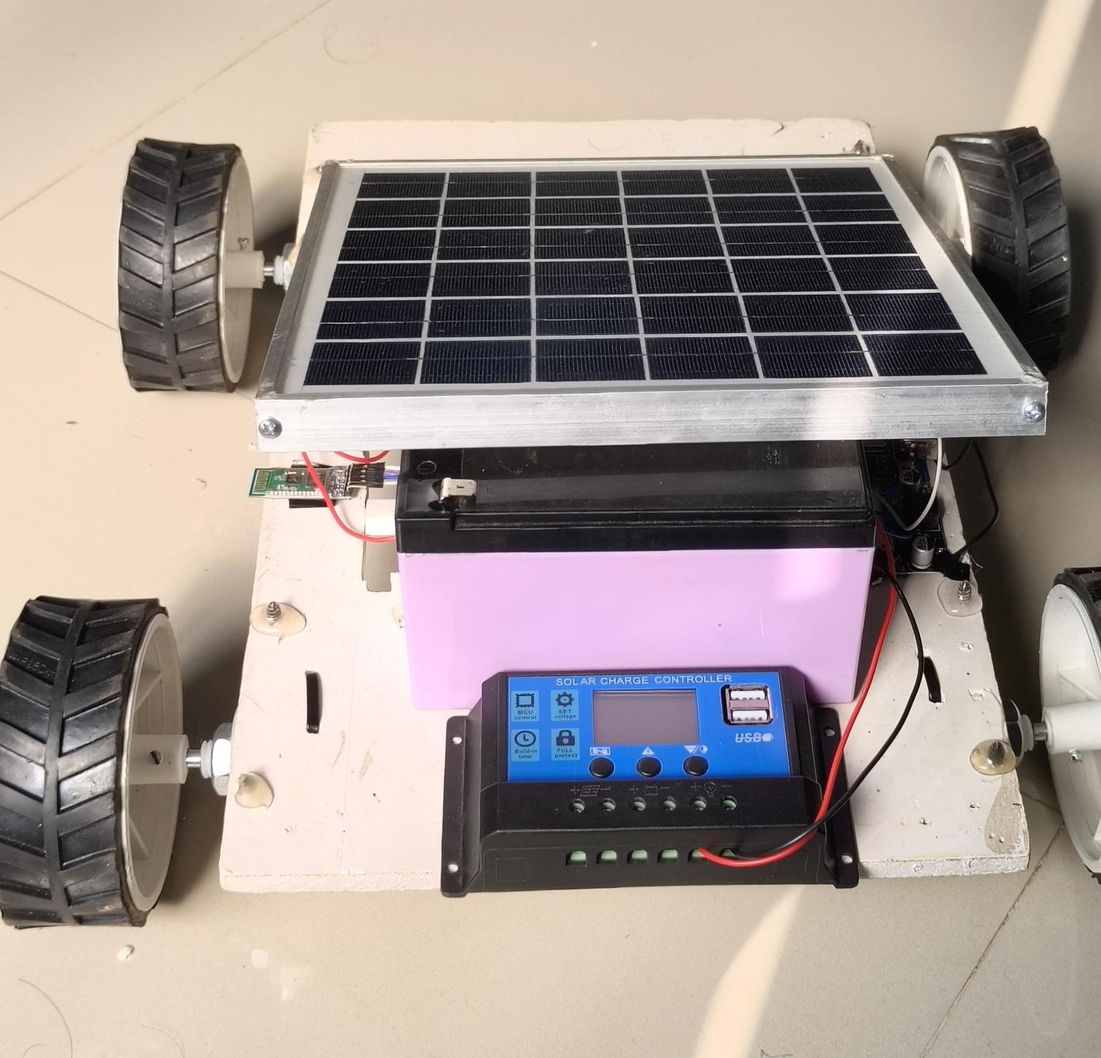
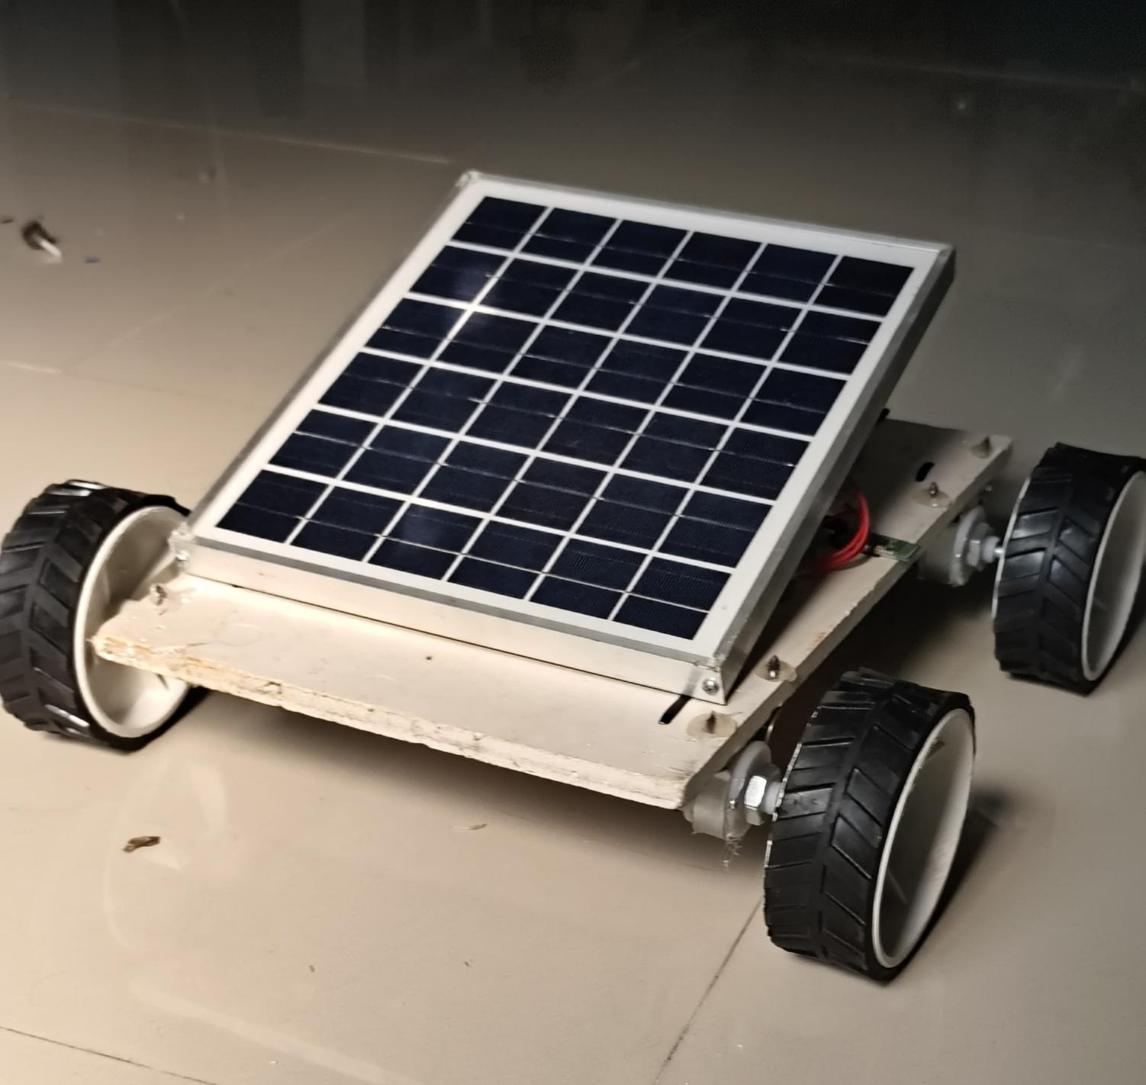
.

Slide 14
Problems Faced During Hardware Implementation
Motor driver overheating when four motors were connected to a single driver.
High current requirement from DC motors causing voltage drops.
Difficulty in smooth turning due to friction between wheels and ground.
Bluetooth communication delay or disconnection during testing.
Power management issues when integrating solar panel, battery, and buck converter.
Mechanical alignment of cutter blade and motor coupling.

Slide 15
Applications
Gardens and lawns
Agricultural fields
Public parks
Residential and industrial areas

Slide 16
Advantages
Eco‑friendly system using solar energy.
Reduces human effort.
Wireless remote operation.
Low operational cost.
Suitable for small lawns and gardens

Slide 17
Conclusion
Eco‑friendly and energy‑efficient solution.
Reduces manual effort in grass cutting.
Suitable for small‑scale lawn maintenance.
Future enhancement: automatic obstacle avoidance.

Slide 18
THANK YOU
.

